Slide 1
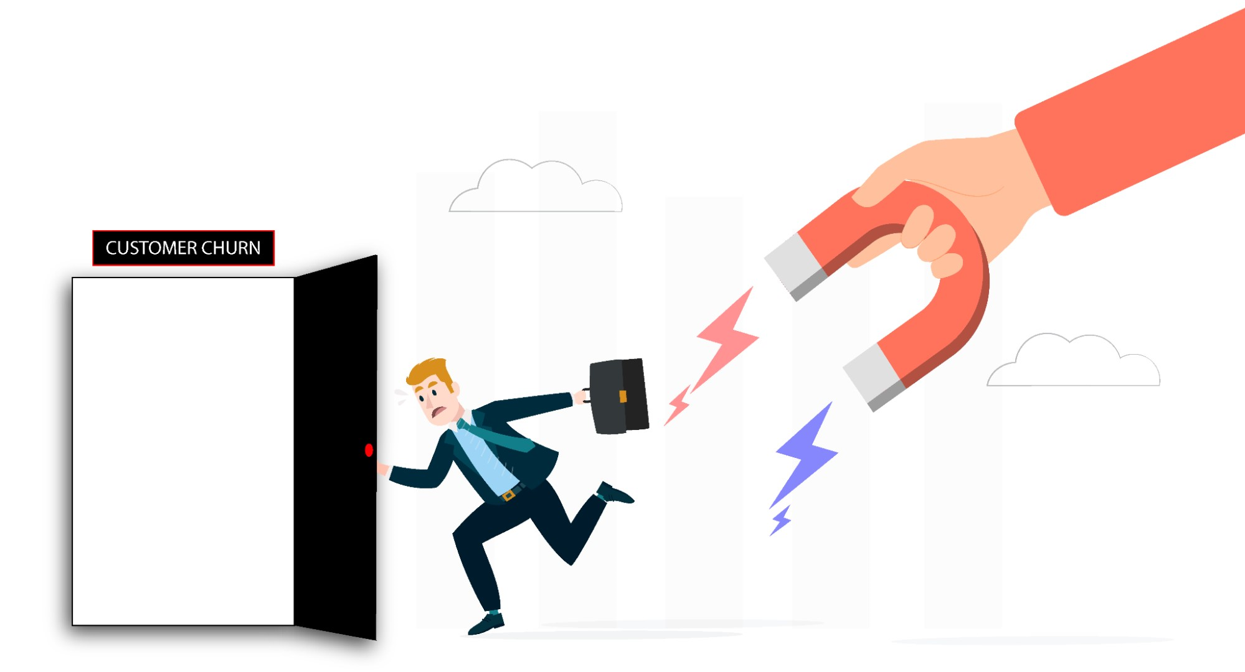
Customer Churn Analysis
By Ananwita Sarkar

Slide 2
Problem Statement: PhoneNow, a telecom company, seeks to enhance customer retention by proactively identifying potential churn risks. The company currently relies on post-termination outreach, which is reactive and inefficient. The Retention Manager aims to develop a dashboard that visually represents key performance indicators (KPIs) for customer retention. The challenge lies in utilizing customer data, including services subscribed, account information, and demographic details, to pinpoint customers at risk of churning. The goal is to empower the management with self-explanatory insights for effective decision-making and proactive customer retention strategies.
Tech Stack Used: Power BI will be employed to analyze and visualize the data effectively. Its features, such as data cleaning, transformation, and interactive visualizations, align well with the project requirements. Power BI's capabilities will enable the creation of an intuitive and informative dashboard that presents KPIs, customer behavior trends, and churn risks. This tool will empower the Retention Manager to make data-driven decisions and devise proactive strategies for customer retention, ensuring the company's growth and customer satisfaction.
Approach: The approach involves defining relevant KPIs to assess customer retention, gathering and preparing data on terminated customers, services, and demographics. Power BI will be used for comprehensive analysis, creating interactive visualizations and relationships. The dashboard will highlight KPIs, customer trends, and churn risks, aiding proactive identification of at-risk customers and informing strategic decisions. Recommendations will be drawn from the analysis to enhance customer retention strategies. Link to the dashboard: https://drive.google.com/file/d/1OGowQupsa7DZsSVqeoOPOiiu2PNmU7Fg/view?usp=sharing

Slide 3
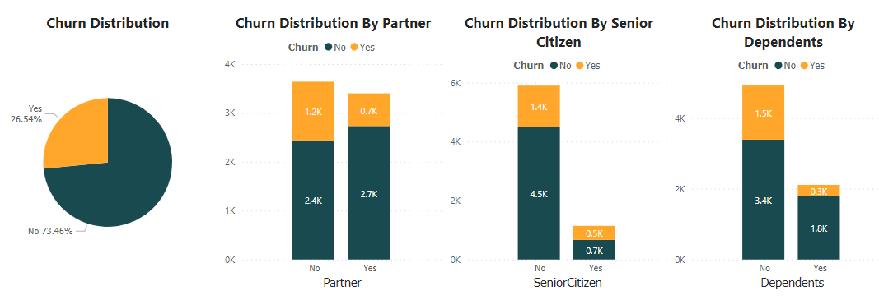
Demographics Report
Approximately a quarter of the entire distribution represents customer churn, with a notable tendency for individuals with partners to exhibit higher churn rates. A comparable observation can be made regarding senior citizens, who constitute a smaller proportion within the telecom company, yet experience elevated churn. Furthermore, those without dependents express heightened interest, yet simultaneously demonstrate a propensity for churn. Given these insights, it is advisable for the company to prioritize these specific areas for concentrated efforts.

Slide 4
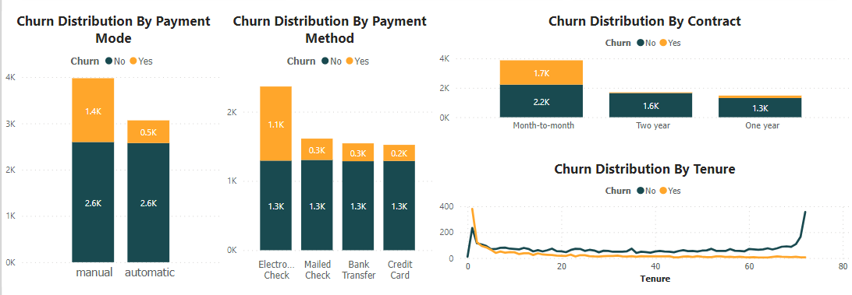
Payments and Tenure Report
A clear trend emerges when examining payment preferences among customers, with those who choose manual payment methods exhibiting a higher likelihood of churn. Notably, customers utilizing electronic checks for payments show the most significant churn rate. Another noteworthy observation pertains to contract duration, as a higher interest in month-to-month contracts is evident; however, these customers face a higher churn rate compared to those on one or two-year contracts. Over the years, there has been a decline in the overall churn distribution, as indicated by tenure data. To address these patterns, the company should focus its attention on rectifying issues associated with manual payment modes, particularly electronic checks. Additionally, a thorough investigation into the reasons behind the elevated churn among month-to-month contract holders is recommended.

Slide 5
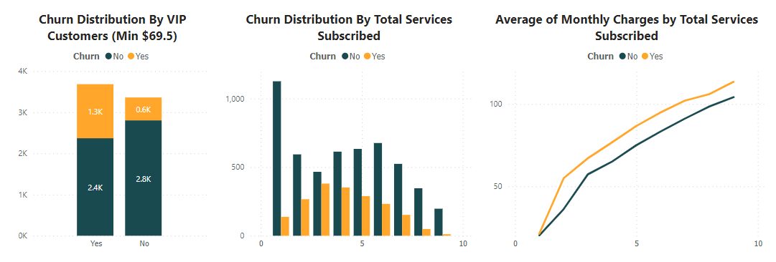
VIP Customers Report
Based on the provided charts, it is evident that VIP customers exhibit a higher likelihood of churning compared to non-VIP customers. Moreover, a significant number of customers with subscription counts ranging from 1 to 6 experience higher churn rates compared to those with greater subscription counts. This observation aligns with the finding that customers who churn tend to have elevated average monthly charges in contrast to their non-churning counterparts. Additionally, it is worth noting that the combined total of services subscribed by customers who remain active surpasses that of customers who have churned. These insights collectively provide valuable information for understanding the dynamics of customer behavior, subscriptions, average charges, and churn within the telecom company's context.

Slide 6
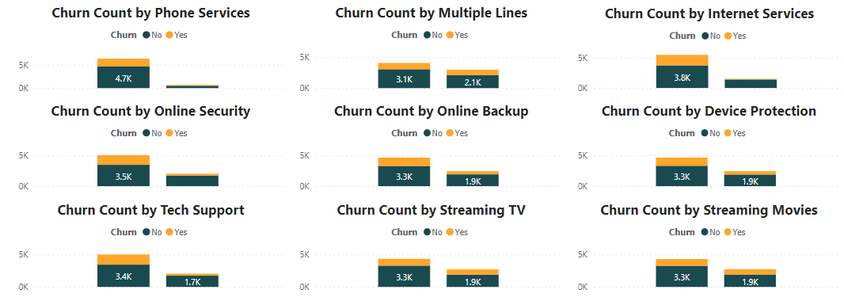
Services Report
The analysis of the chart reveals distinct patterns in customer preferences and corresponding churn rates across various services. Phone service garners significant interest with a comparatively low churn rate. Conversely, services like multiple lines, online security, online backup, device protection, tech support, streaming TV, and streaming movies exhibit lower customer engagement but higher churn rates. Sadly, internet service captures customer interest yet experiences a disproportionately high churn rate. This emphasizes the urgency for the company to address underlying issues impacting internet service and to strategize improvements for services with high churn rates despite low initial interest.

Slide 7
Insights
Around 25% of the distribution reflects churn. Customers with partners and senior citizens show higher churn, while interest from those without dependents coincides with increased churn. These areas require focused attention.
Manual payments and electronic checks link to higher churn. Month-to-month contracts, popular but with higher churn, need investigation. Overall churn has declined, addressing payment modes crucial.
VIP customers churn more. Subscribers with 1-6 services churn more than those with more services subscribed. Higher average charges link to churn. Active customers have more subscribed services than churned.
Customer preferences and churn patterns vary across services. Phone service has low churn, while less-engaged services like multiple lines and online security face high churn. Urgent action needed for high-churn internet service.

Slide 8
THANK YOU

